Slide 1
Introduction :Context and purpose of analysis
Purpose of the Project
The primary goal of this project was to explore and execute all stages of the Extract, Transform, and Load(ETL) process, alongside other essential data analysis techniques, to deepen our understanding of data handling and preparation. Through this hands-on approach, we aimed to familiarize ourselves with Power BI, learning how to effectively manage, visualize, and interpret data.
By engaging in these processes, we not only developed technical skills in Power BI but also gained valuable insights into the practical workflow of transforming raw data into actionable insights. This experience will enhance our ability to apply similar techniques in future data projects.
In addition, the analysis aims to:
Identify top-performing countries based on revenue.
Analyze the contribution of revenue by bike types.
Summarize key metrics to aid in better decision-making for targeted marketing and inventory management.

Slide 2
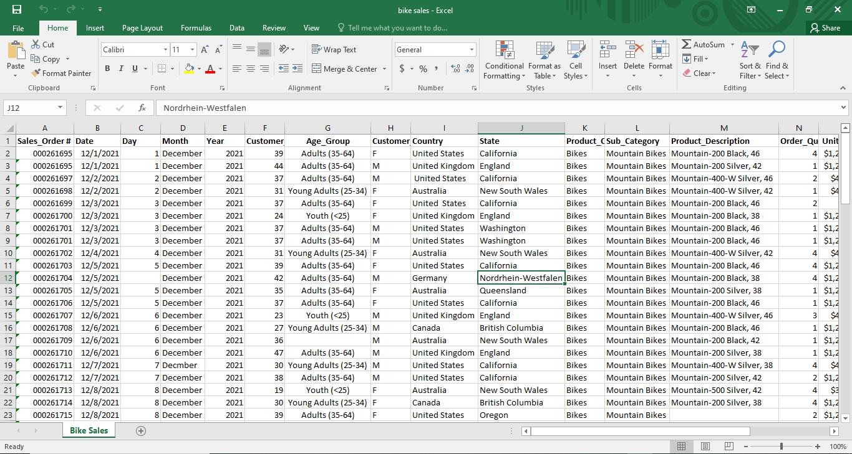
ETL process for bike sales dataset to get into the PowerBI tool in readiness for analysis
Bike sales dataset before the ETL process

Slide 3
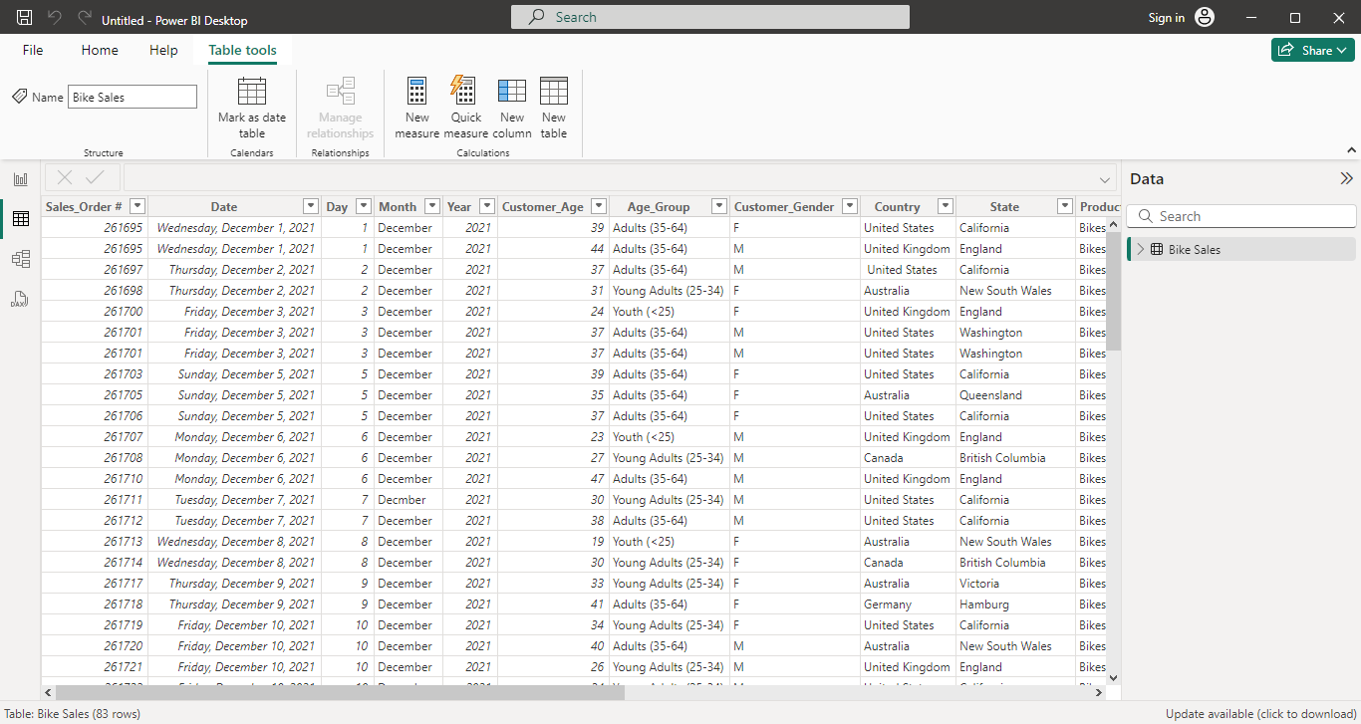
ETL PROCESS
BIKE SALES DATASET AFTER ETL PROCESS
The transformed data is imported into Power BI for visualization and analysis.
1.Extraction :The extraction phase involves retrieving the raw data. Source: The "bike sales" dataset . Tools: Power BI Desktop (Direct extraction)
2. Transform :The transformation phase cleans, reshapes, and prepares data for analysis. Power BI has a built-in Power Query Editor for this. Operations Performed in Power Query are data cleaning, data enrichment, data restructuring, data filtering and data type conversion
3. Load: After transforming the data, the cleaned and structured dataset is loaded into Power BI's data model.

Slide 4
Kind of analysis we performed on bike sales data.
Descriptive Analysis
Using Descriptive Analysis for the Bike Sales Dashboard
Descriptive analysis involves summarizing and interpreting raw data to highlight patterns, trends, and key statistics. For our bike sales dashboard in Power BI, we utilized descriptive analysis to achieve the following:
Data Collection and Preparation
We began by importing the bike sales dataset into Power BI, ensuring all relevant data fields were included.
During the ETL process, we cleaned the data to remove duplicates, handle missing values, and standardize formats for consistency.
Identifying Key Metrics
We determined the key metrics to display, such as Revenue, Number of Products (Order_Quantity) and Unit Price.
These metrics helped us understand the overall performance and identify areas requiring further analysis.
Visual Representation
Using Power BI’s visual tools, we created dynamic visuals to represent the data clearly
The dashboard consists of key performance indicators using Cards, a stack column chart for revenue by Product_Description, and a Map visualizing revenue distribution across countries.
Trends and Patterns
The visuals helped identify patterns, such as Top Bike Models(Product_Description) and Revenue by Country .
For example, The United States generated the highest revenue, contributing $124526, while Country United Kingdom recorded the least revenue contributing $19972.
Dashboards for Insights
By combining these visuals, we built an interactive dashboard that provided an at-a-glance view of the sales performance.
Filters and slicers allowed us to explore data by categories such as region or product type, making the dashboard user-friendly and insightful.
Through descriptive analysis, we transformed raw data into meaningful insights that are easily interpretable, helping to make data-driven decisions about inventory, marketing, and sales strategies.

Slide 5
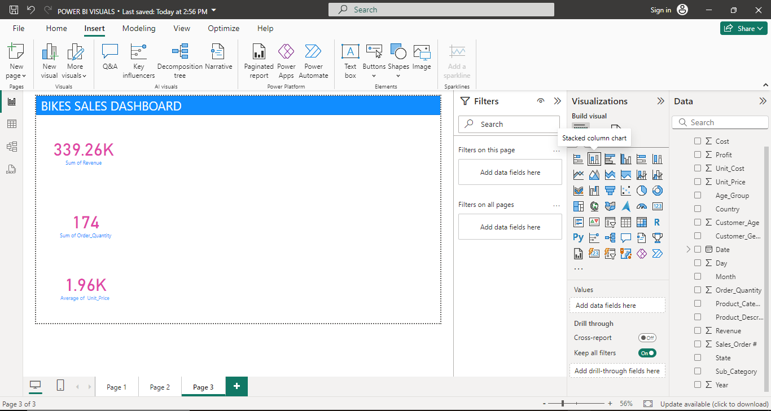
Cards: Metrics Included: Revenue: Displays the total revenue. Number of Products (Order_Quantity): Shows total products sold. Unit Price: Displays the average unit price. These cards provide an at-a-glance summary of overall performance

Slide 6
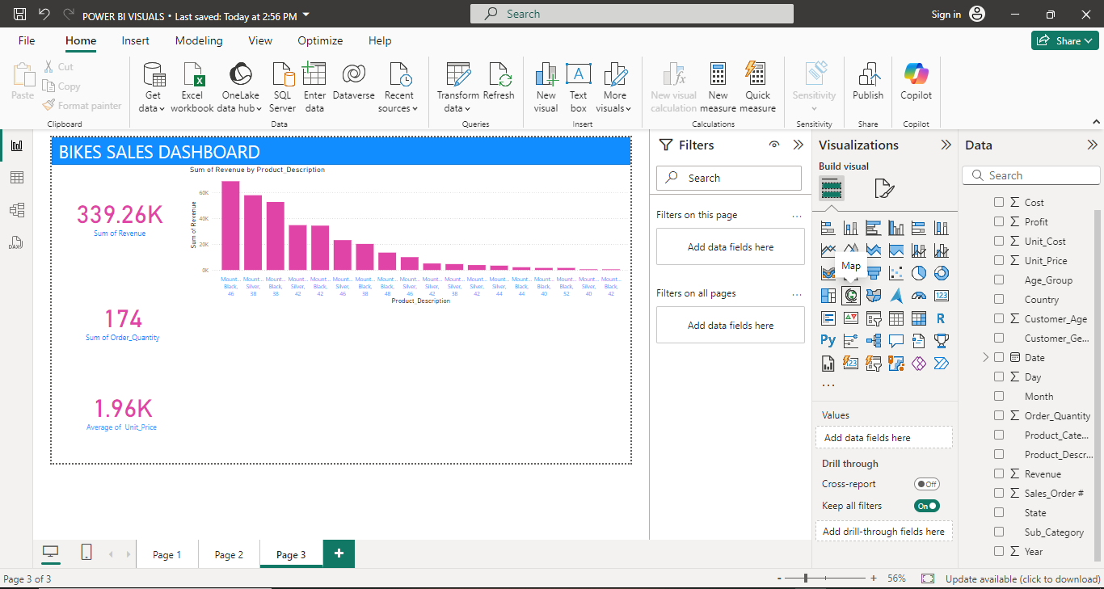
Stacked Column Chart: Revenue by Product _Description: The stacked column chart breaks down revenue by Product_Description, identifying which categories contribute most to total sales.

Slide 7
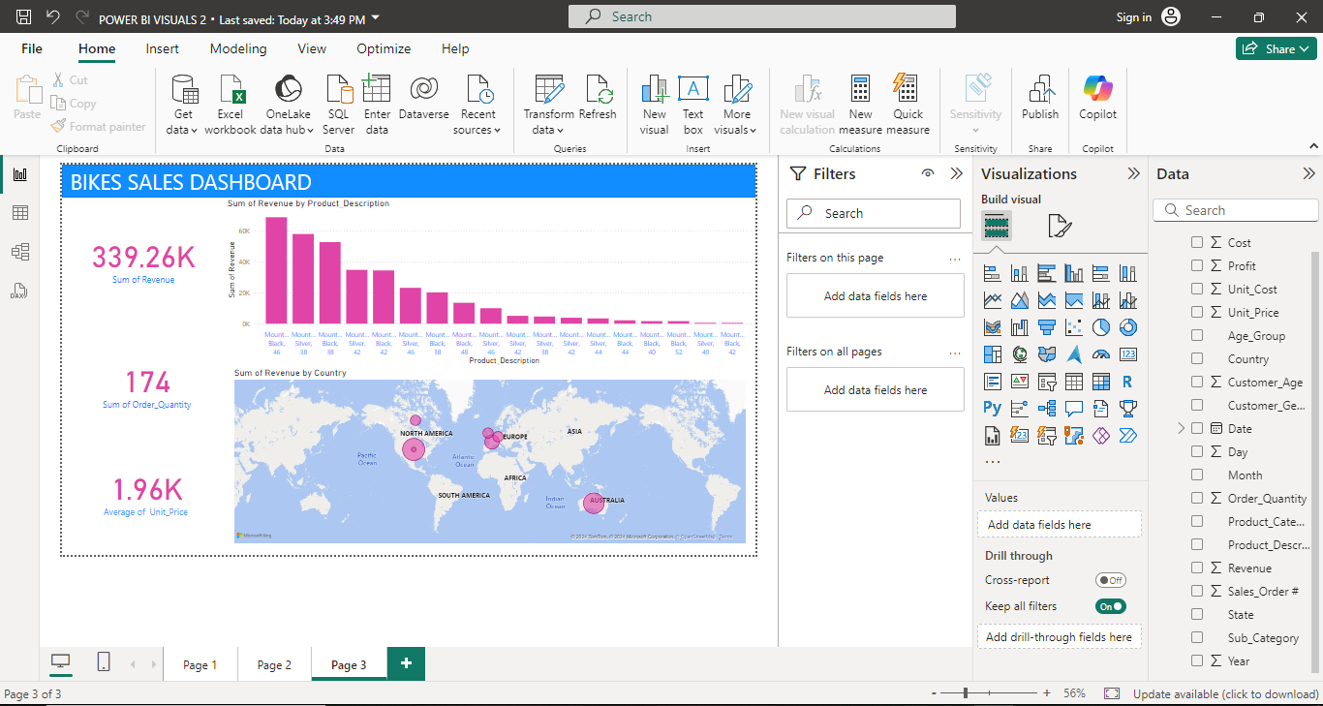
Map: Revenue by Country: The map visualizes revenue distribution across countries, making it easy to identify high-performing regions

Slide 8
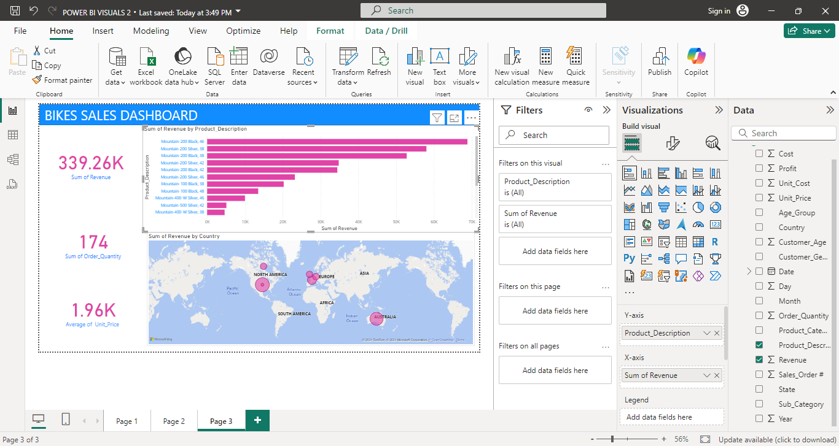
I changed the stacked column chart to a stacked bar chart to better visualize the data horizontally, making it easier to compare the Revenue across different Product_Description.

Slide 9
Results, Insights, and Achievements
Achievements
Comprehensive Data Analysis: Successfully applied the ETL process and conducted descriptive analysis to extract valuable insights from the dataset.
Interactive Dashboard Creation: Developed a user-friendly Power BI dashboard featuring key metrics (KPIs), a stacked column chart, and a map for visualizing data effectively.
Insightful Metrics: Highlighted essential business insights, such as top-performing bike models, revenue distribution by country, and overall sales performance.
Team Collaboration: Worked effectively as a team to analyze, interpret, and present the data while improving Power BI skills.
Data-Driven Recommendations: Identified actionable insights to guide business strategies, such as focusing on top products and exploring growth opportunities in underperforming regions.
Insights and Findings
Summary of Metrics (from Cards):
Revenue: The total revenue generated was $339.26K.
Quantity of Products Sold: A total of 174 products were sold.
Unit Price: The average unit price was $1.96K.
Revenue by Product_Description:
Mountain 200, Black: 46 bikes accounted for $68,850 (20.3%) of total revenue.
Mountain 200, Silver: 38 bikes accounted for $58,000 (17.1%) of total revenue.
Revenue by Country (from Map):
The United States generated the highest revenue, contributing $124,526.
The United Kingdom recorded the least revenue, contributing $19,972.
Revenue by Country - Interpretation and Strategies
United States: High revenue indicates strong market demand. Successful marketing and product offerings likely contribute to this performance.
United Kingdom: Lower revenue suggests challenges such as market saturation, low brand awareness, or mismatched product offerings.
Strategies to Improve Sales in the United Kingdom:
Targeted Marketing: Localized campaigns and promotional offers tailored to UK preferences.
Market Research: Understand consumer behavior and segment the market for personalized offers.
Partnerships: Collaborate with UK retailers and influencers to increase product visibility.
Product Adjustments: Offer bikes suited to UK-specific needs and consider revising pricing strategies.
Customer Engagement: Collect feedback to improve products and launch loyalty programs.
These strategies focus on increasing brand awareness, adapting to local preferences, and improving customer engagement in the UK.
Conclusion
The analysis revealed the following key insights:
Top-performing Products: Mountain 200, Black bikes led sales, generating the most revenue.
Revenue Distribution: The United States is the highest contributor to revenue, while the United Kingdom represents a smaller share.
Actionable Insights: These findings suggest that targeted marketing efforts should focus on promoting Mountain 200, Black bikes and expanding in regions like the United Kingdom to drive growth.

